Slide 1
Airline Reservation System
Sifat Ul Alam (16.01.04.041)
Md. Sajidul Hoque (16.01.04.049)

Slide 2
Project Objective
The main objective of this project is to design and develop an Airline Reservation System. This project is mainly intended for the customers, who use the airline websites to make reservations on flights. The users will be able to the time and places of their flights. Users can buy tickets either through an agent or through a flight company. The system will also provide information about the workers working at different airport with their salary, job description and personal information.

Slide 3
Features of the Project
Provide information about airport, flight, ticket, supplier and worker. City, name of airport. Flight number, arrival hour, departure hour, Arrival airport, departure airport of a flight. User can book tickets in two different ways. Either through a flight company or a booking agent and collect information about their tickets. The airline companies can access the employee’s details like their name, salary and other information who work at different airports.

Slide 4
Types of Users
Passenger.
Supplier (Agent or Flight Company).

Slide 5
Features grouping according to the users
Features for Passenger:
Access information about Flight information like arrival and departure hour, airport name and city. They can book tickets in two ways (agent or Flight Company).
Features for supplier:
Suppliers can access passenger names and their flight information. They can also access worker details like their salary, job description and personal details.

Slide 6
Name of the entities with primary key
Airport: id
Worker: WorkerID
Employed: AirportId, WorkerID
Flight: FlightNumber
INOUT: AirportId, FlightNumber
Ticket: OrderNumber
Supplier: SupplierID
Flight Company: SupplierID
BookingAgent: SupplierID
Purchase: FlightNumber, SupplierID

Slide 7
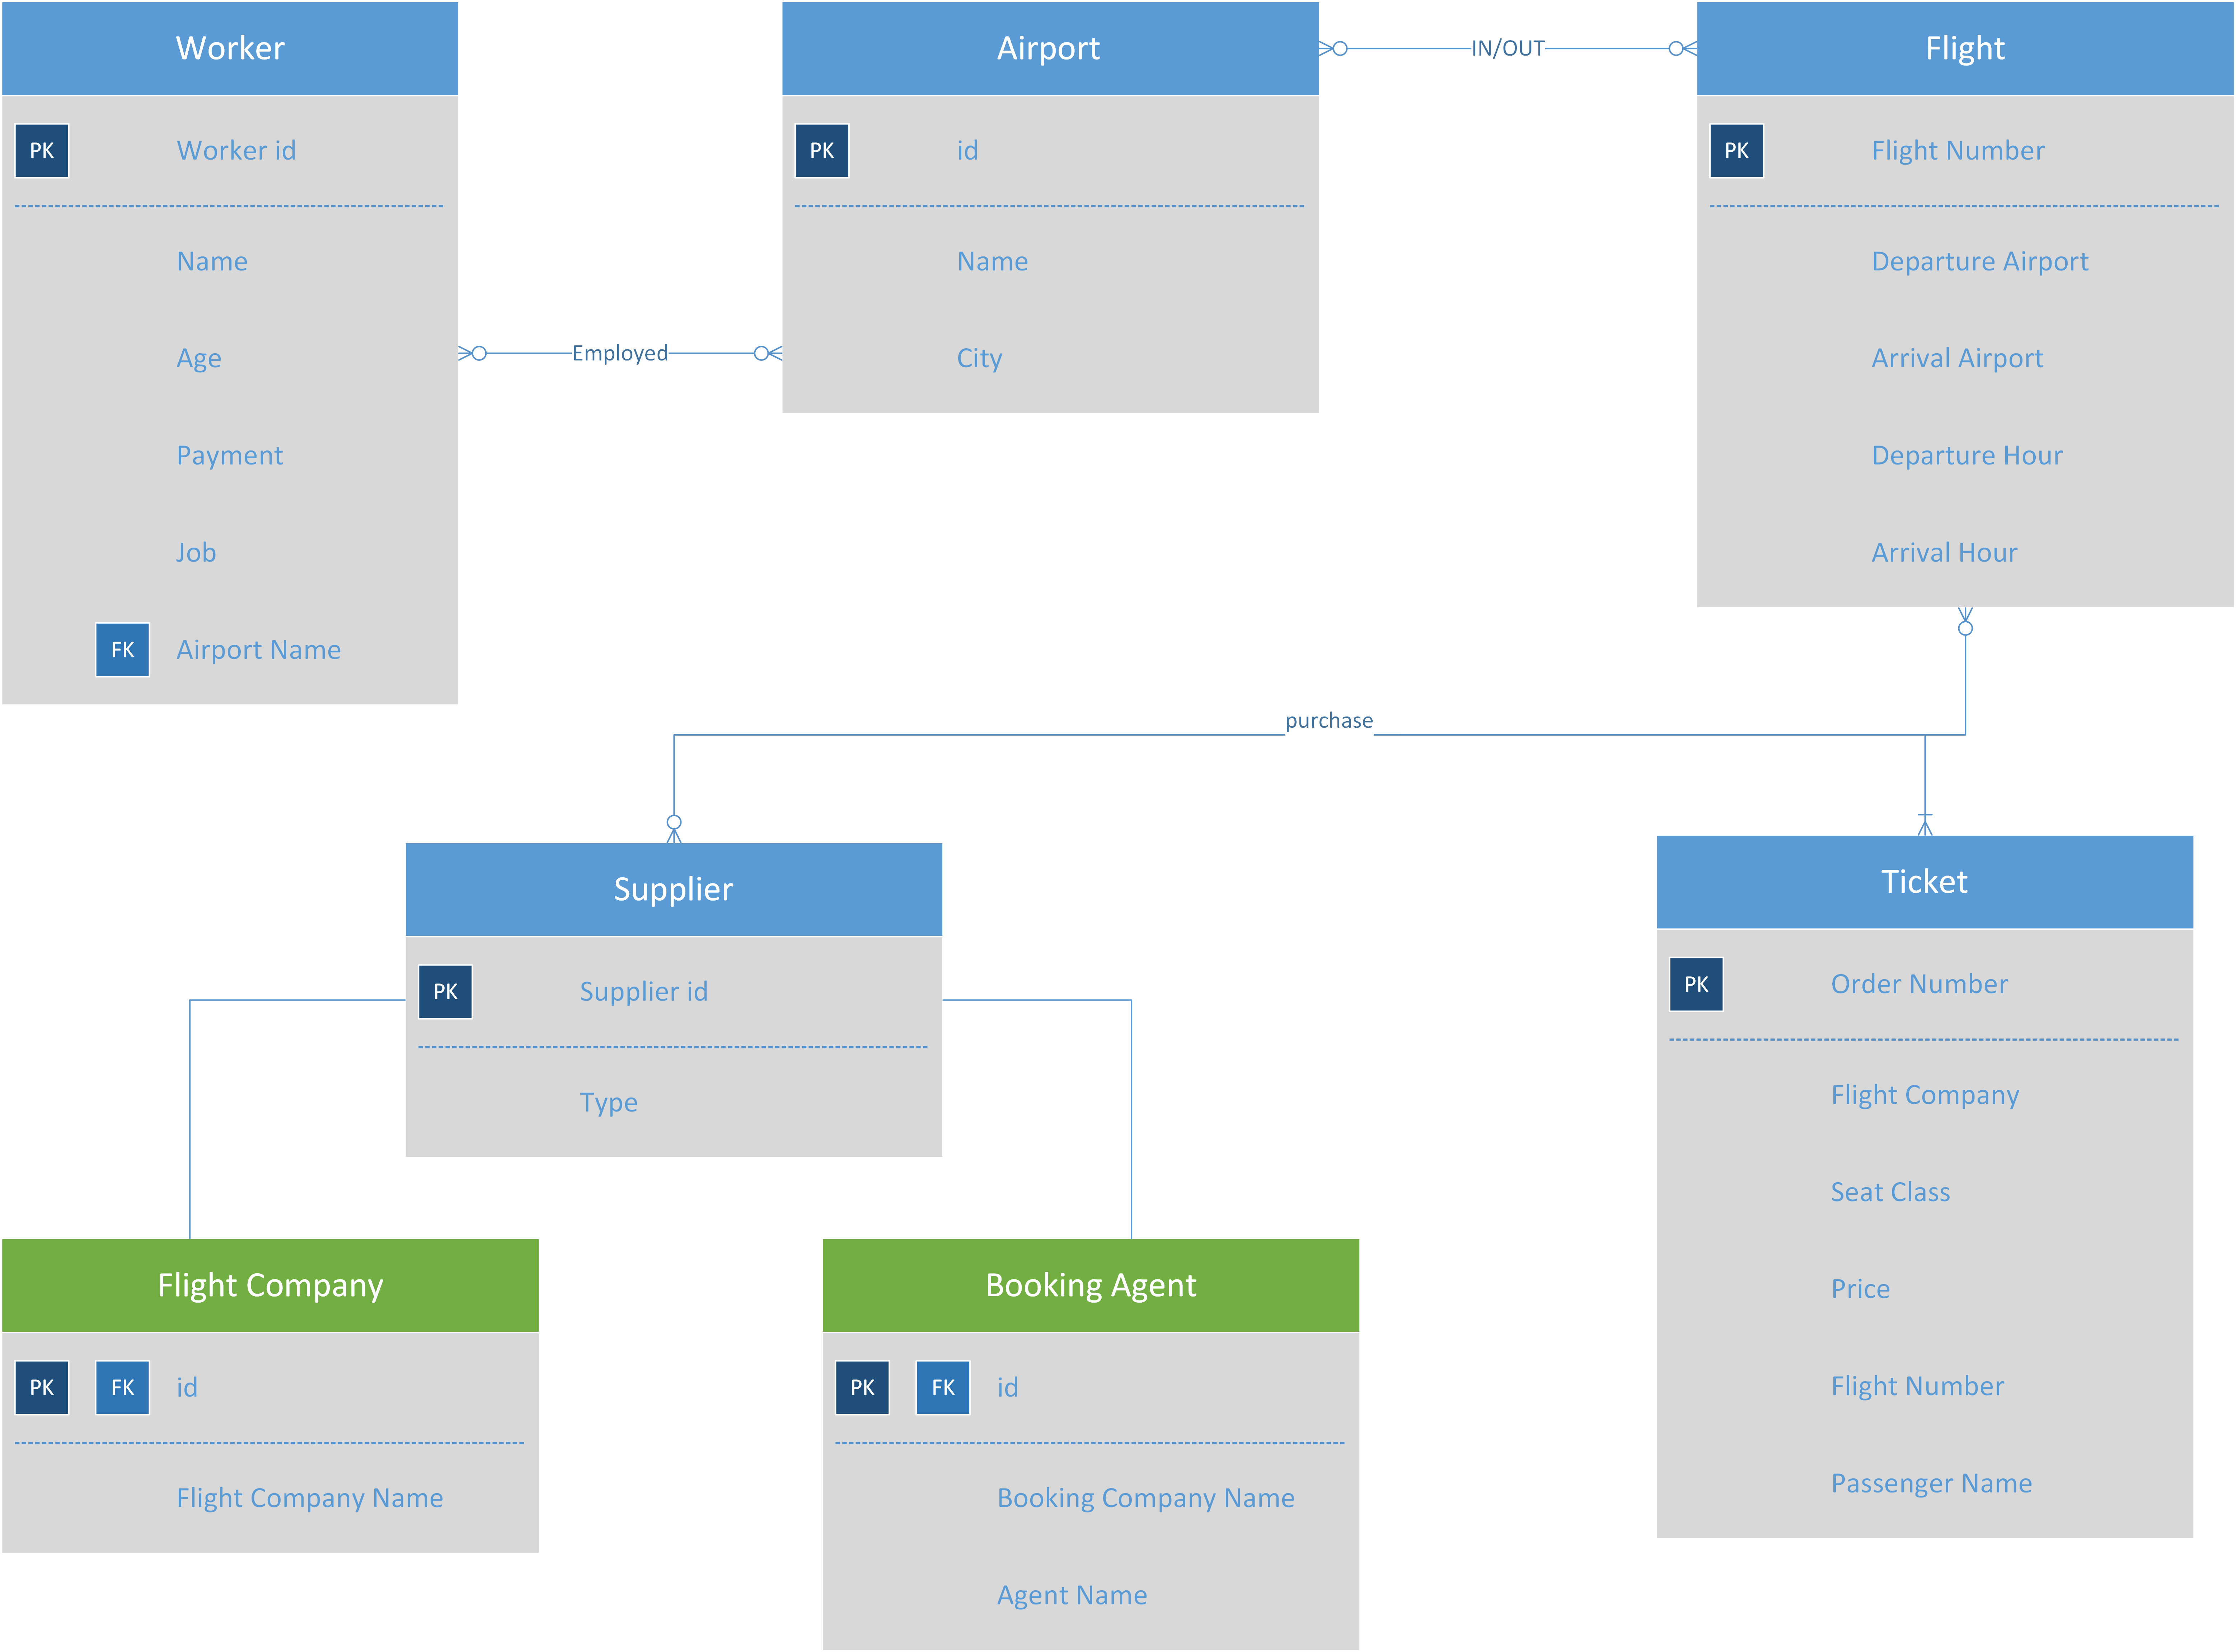
Entity Relationship Diagram

Slide 8
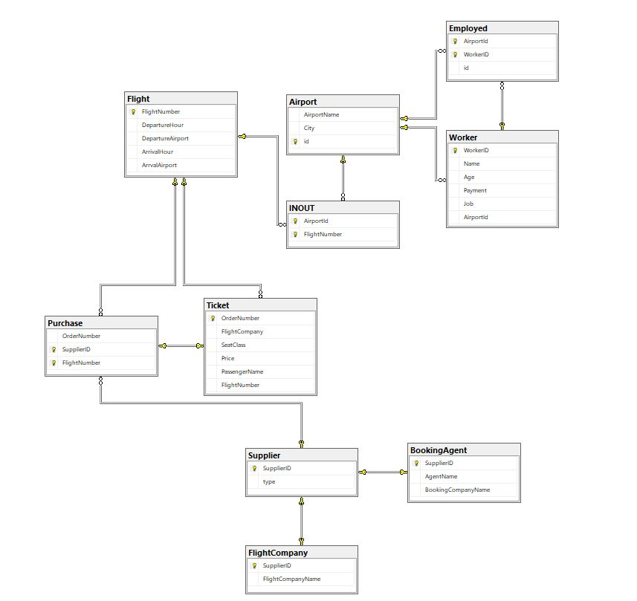
Database Diagram

Slide 9
SQL Queries Grouped Under diff. types of users
Passenger:
→ 1. Show all the airport information
SELECT * FROM Airport
→ 2. Show all the Flight Details
SELECT * FROM Flight
→ 3. Show all the ticket information
SELECT * FROM Ticket
→ 4. Show all the supplier info who are Flight Company
SELECT * FROM FlightCompany
→ 5. Show all the supplier info who are Booking Agent
SELECT * FROM BookingAgent

Slide 10
SQL Queries Grouped Under diff. types of users
→ 6. Show all the airports that are in Dhaka
SELECT * FROM Airport WHERE City='Dhaka'
→ 7. Show the location of Shah Poran Airport
SELECT * FROM Airport WHERE AirportName='Shah Poran Airport'
→ 8. Show the airports that starts with Shah
SELECT * FROM Airport WHERE AirportName='Shah%‘
→ 9. Show the arrival hour of Flight Number 1
SELECT ArrivalHour FROM Flight WHERE FlightNumber = 1
→ 10. Show all the Flights leaving Shahjalal Airport
SELECT * FROM Flight WHERE
DepartureAirport IN (SELECT id FROM Airport WHERE AirportName='Shahjalal Airport')

Slide 11
SQL Queries Grouped Under diff. types of users
→ 11. Show the last departure hour of Flight No. 2
SELECT TOP 1 * FROM Flight WHERE FlightNumber= 2 ORDER BY DepartureHour DESC
→ 12. Show all the flights arriving at Chennai Airport
SELECT * FROM Flight WHERE ArrivalAirport IN (SELECT id FROM Airport WHERE AirportName='Chennai International Airport')
→ 13. Show all the flights arriving at Dhaka City
SELECT * FROM Flight WHERE ArrivalAirport IN (SELECT id FROM Airport WHERE City='Dhaka')
→ 14. Show the Departure airport of Flight No. 3
SELECT DepartureAirport FROM Flight WHERE FlightNumber = 3
→ 15. Show the Flights arriving at Chennai today
SELECT * FROM Flight WHERE cast(GETDATE() as DATE) = cast(ArrivalHour as DATE)
AND ArrivalAirport IN
(SELECT id FROM Airport WHERE AirportName='Chennai International Airport')

Slide 12
SQL Queries Grouped Under diff. types of users
→16. Show the Flights leaving Dhaka Today
SELECT * FROM Flight WHERE
cast(GETDATE() as DATE) = cast(DepartureHour as DATE) AND DepartureAirport IN (SELECT id FROM Airport WHERE City='Dhaka')
→17. Show the flights that arrived at Sylhet 28th September 2018
SELECT * FROM Flight WHERE cast(ArrivalHour as DATE) = '2018-09-28' AND ArrivalAirport
IN (SELECT id FROM Airport WHERE City='Sylhet')
→ 18. Show the flight leaving Dhaka for Sylhet Today after 7 pm.
SELECT * FROM Flight WHERE cast(DepartureHour as DATE) = cast(GETDATE() as DATE)
AND DATEPART(HOUR, GETDATE()) >= 19 AND ArrivalAirport
IN (SELECT id FROM Airport WHERE City='Sylhet')
AND DepartureAirport IN (SELECT id FROM Airport WHERE City='Dhaka')

Slide 13
SQL Queries Grouped Under diff. types of users
→ 19. Show the flight arriving Chennai From Dhaka Today after 10 pm.
SELECT * FROM Flight WHERE cast(ArrivalHour as DATE) = cast(GETDATE() as DATE)
AND DATEPART(HOUR, GETDATE()) >= 22 AND DepartureAirport
IN (SELECT id FROM Airport WHERE City='Dhaka')
AND ArrivalAirport IN (SELECT id FROM Airport WHERE City = 'Chennai')
→ 20. Show the ticket price of each Seat Class That leaves Dhaka and goes to Chennai
SELECT SeatClass, Price FROM Ticket WHERE FlightNumber
IN (SELECT FlightNumber FROM Flight WHERE DepartureAirport
IN (SELECT id FROM Airport WHERE City = 'Dhaka')
AND ArrivalAirport
IN (SELECT id FROM Airport WHERE City = 'Chennai')) GROUP BY SeatClass, Price

Slide 14
SQL Queries Grouped Under diff. types of users
Supplier:
→ 21. Show all the Worker Information
SELECT * FROM Worker
→ 22. Show the flights arriving three days ago
SELECT * FROM Flight WHERE ArrivalHour = DATEADD(day, -3, GETDATE())
→ 23. Show all the Passenger name Details Who are in Business Class in Flight number 1
SELECT PassengerName FROM Ticket WHERE SeatClass='Business' AND FlightNumber = 1
→ 24. Show the ticket price of each Seat Class Where Flight Number = 1
SELECT SeatClass, Price FROM Ticket WHERE FlightNumber = 1 GROUP BY SeatClass, Price
→ 25. Show the passenger details of order number 2
SELECT * FROM Ticket WHERE OrderNumber = 2

Slide 15
SQL Queries Grouped Under diff. types of users
→ 26. Show the passenger details under US Bangla Airline
SELECT * FROM Ticket WHERE FlightCompany IN (SELECT SupplierID FROM FlightCompany WHERE FlightCompanyName='US Bangla%')
→ 27. Show the tickets sold under Different Flight Companies
SELECT B.Name, Total from (SELECT FlightCompany, COUNT(Ordernumber) AS 'Total' FROM Ticket
GROUP BY FlightCompany) A JOIN
(SELECT SupplierID, FlightCompanyname AS 'Name' FROM FlightCompany UNION
SELECT SupplierID, BookingCompanyName FROM BookingAgent) B
ON A.FlightCompany=B.SupplierID
→ 28. Find the passengers who booked under booking agent named Eimo
SELECT PassengerName FROM Ticket WHERE
FlightCompany IN (SELECT SupplierID FROM BookingAgent WHERE AgentName='Eimo')
→ 29. Find the agent name of the passenger Name Nabil
SELECT AgentName FROM BookingAgent WHERE SupplierID IN (SELECT FlightCompany FROM Ticket WHERE PassengerName = 'Nabil')

Slide 16
SQL Queries Grouped Under diff. types of users
→ 30. Find the passenger who booked under Flight Company
SELECT * FROM Ticket WHERE FlightCompany IN (SELECT SupplierID FROM FlightCompany)
→ 31. Find the passenger who booked under Booking Agent
SELECT * FROM Ticket WHERE FlightCompany IN (SELECT SupplierID FROM BookingAgent)
→ 32. Find the booking company name of an agent named Faisal
SELECT BookingCompanyName FROM BookingAgent WHERE AgentName='Faisal'
→ 33. Find the total number of bookings of booking companies
SELECT B.Name, Total from
(SELECT FlightCompany, COUNT(Ordernumber) AS 'Total' FROM Ticket
GROUP BY FlightCompany) A JOIN
(SELECT SupplierID, BookingCompanyName AS 'Name' FROM BookingAgent) B
ON A.FlightCompany=B.SupplierID

Slide 17
SQL Queries Grouped Under diff. types of users
→ 34. Find the total number of bookings under Flight company
SELECT B.Name, Total from
(SELECT FlightCompany, COUNT(Ordernumber) AS 'Total' FROM Ticket
GROUP BY FlightCompany) A JOIN
(SELECT SupplierID, FlightCompanyname AS 'Name' FROM FlightCompany) B
ON A.FlightCompany=B.SupplierID
→ 35. Show the Workers who work at Shahjalal Airport
SELECT * FROM Worker WHERE AirportId IN
(SELECT id FROM Airport WHERE AirportName = 'Shahjalal Airport')
→ 36. Show The payments of all the workers in Descending order
SELECT * FROM Worker ORDER BY Payment DESC
→ 37. List out the workers who earn between 15000 and 20000
SELECT * FROM Worker WHERE Payment >= 15000 AND Payment <= 20000

Slide 18
SQL Queries Grouped Under diff. types of users
→ 38. List out the top three earning workers
SELECT TOP 3 Name FROM Worker ORDER BY Payment DESC
→ 39. Show the second most earning Worker
SELECT TOP 1 Name FROM Worker
WHERE Payment <> MAX(Payment)
ORDER BY Payment DESC
→ 40. Show the third most earning Worker
SELECT TOP 1 Name FROM (SELECT TOP 3 * FROM Worker ORDER BY Payment DESC)B ORDER BY Payment DESC
→ 41. Show the Maximum, Average and Minimum Payment of workers according to Job
SELECT Job, Max(Payment) AS 'Max Salary',
Min(Payment) AS 'Min Salary',
AVG(Payment) AS 'AVG Salary'
FROM Worker Group By Job

Slide 19
SQL Queries Grouped Under diff. types of users
→ 42. Increase the Payment of the workers who are above 30 years old
UPDATE Worker SET Payment = Payment + 10000 WHERE Age > 30
→ 43. Increase the Payment of the all the flight Attendent 25%
UPDATE Worker SET Payment = (Payment * 1.25) WHERE Job = 'Flight Attendent‘
→ 44. Show the total worker at each airport
SELECT AirportId, Airport.AirportName, COUNT(WorkerID) AS 'Total Worker' FROM Worker INNER JOIN Airport
ON Worker.AirportId = Airport.id GROUP BY AirportId, AirportName
→ 45. Show the maximum paid worker in each airport
SELECT AirportId, Airport.AirportName, Name AS 'Worker Name', Max(Payment) AS 'Max Payment' FROM Worker
INNER JOIN Airport ON
Worker.AirportId = Airport.id
GROUP BY AirportId, Name, AirportName

Slide 20
Project Limitations
The system is unable to provide detailed information. For Example: the users are unable to know the status of their flight. Not much information about the supplier companies. No Detailed information about airports either.

Slide 21
Conclusion and Future Work
The purpose of our project is to make it easy for people who wants to travel different places both for business or pleasure. The system’s supposed to overcome the problem of wasting valuable time.
We hope to make it more than just a reservation system and overcome all the limitations. We hope one day we can make it a full-fledged airline management system.

